Slide 1

Margaret H. Dunham
Department of Computer Science and Engineering
Southern Methodist University
Companion slides for the text by Dr. M.H.Dunham, Data Mining, Introductory and Advanced Topics, Prentice Hall, 2002.
© Prentice Hall

Slide 2

PART I
  Introduction
  Related Concepts
  Data Mining Techniques
PART II
  Classification
  Clustering
  Association Rules
PART III
  Web Mining
  Spatial Mining
  Temporal Mining
© Prentice Hall

Slide 3

Goal: Examine the use of data mining on the World Wide Web
Introduction
Web Content Mining
Web Structure Mining
Web Usage Mining
© Prentice Hall

Slide 4

Over 1 billion HTML pages, 15 terabytes.
Wealth of information
    Bookstores, restaurants, travel, malls, dictionaries, news, stock quotes,
    yellow & white pages, maps, markets, .........
Diverse media types: text, images, audio, video
Heterogeneous formats: HTML, XML, postscript, pdf, JPEG, MPEG, MP3
© Prentice Hall

Slide 5
Highly Dynamic.
  1 million new pages each day.
  Average page changes in a few weeks.
Graph structure with links between pages
  Average page has 7-10 links.
Hundreds of millions of queries per day
© Prentice Hall

Slide 6

Web pages
Intra-page structures (HTML or XML code for the page)
Inter-page structures (Linkage between web pages)
Usage data
Supplemental data
  Profiles
  Registration information
  Cookies
© Prentice Hall

Slide 7

Finding useful and relevant information.
Creating knowledge from available information.
As the coverage of information is very wide and diverse, personalization of the information is a tedious process.
Learning customer and individual user patterns.
© Prentice Hall

Slide 8
Much of the web information is redundant, as the same piece of information or its variant appears in many pages.
The web is noisy i.e. a page typically contains a mixture of many kinds of information like, main content, advertisements, copyright notice, navigation panels.
© Prentice Hall

Slide 9
The web is dynamic, information keeps changing constantly. Keeping up with the changes and monitoring them are very important.
The Web is also about services. Many Web sites and pages enable people to perform operations with input parameters, i.e., they provide services.
The most important challenge faced is Invasion of Privacy.
© Prentice Hall

Slide 10

This technology has enabled ecommerce to do personalized marketing, which eventually results in higher trade volumes.
The predicting capability of the mining application can benefit the society by identifying criminal activities.
The companies can establish better customer relationship by giving them exactly what they need.
© Prentice Hall

Slide 11
Companies can understand the needs of the customer better and they can react to customer needs faster.
The companies can find, attract and retain customers, they can save on production costs by utilizing the acquired insight of customer requirements.
They can increase profitability by target pricing based on the profiles created.
© Prentice Hall

Slide 12
They can even find the customer who might default to a competitor the company will try to retain the customer by providing promotional offers to the specific customer, thus reducing the risk of losing a customer
© Prentice Hall

Slide 13

STRUCTURE
Data Mining :
Data is structured and has well defined tables, columns, rows, keys and constraints.
Web Mining
Dynamic and rich in features and patterns.
© Prentice Hall

Slide 14
Web mining involves analysis of web server logs of a website whereas data mining involves using techniques to find relationships in large amounts of data.
SPEED
Often need to react to evolving usage patterns in real time .
© Prentice Hall

Slide 15

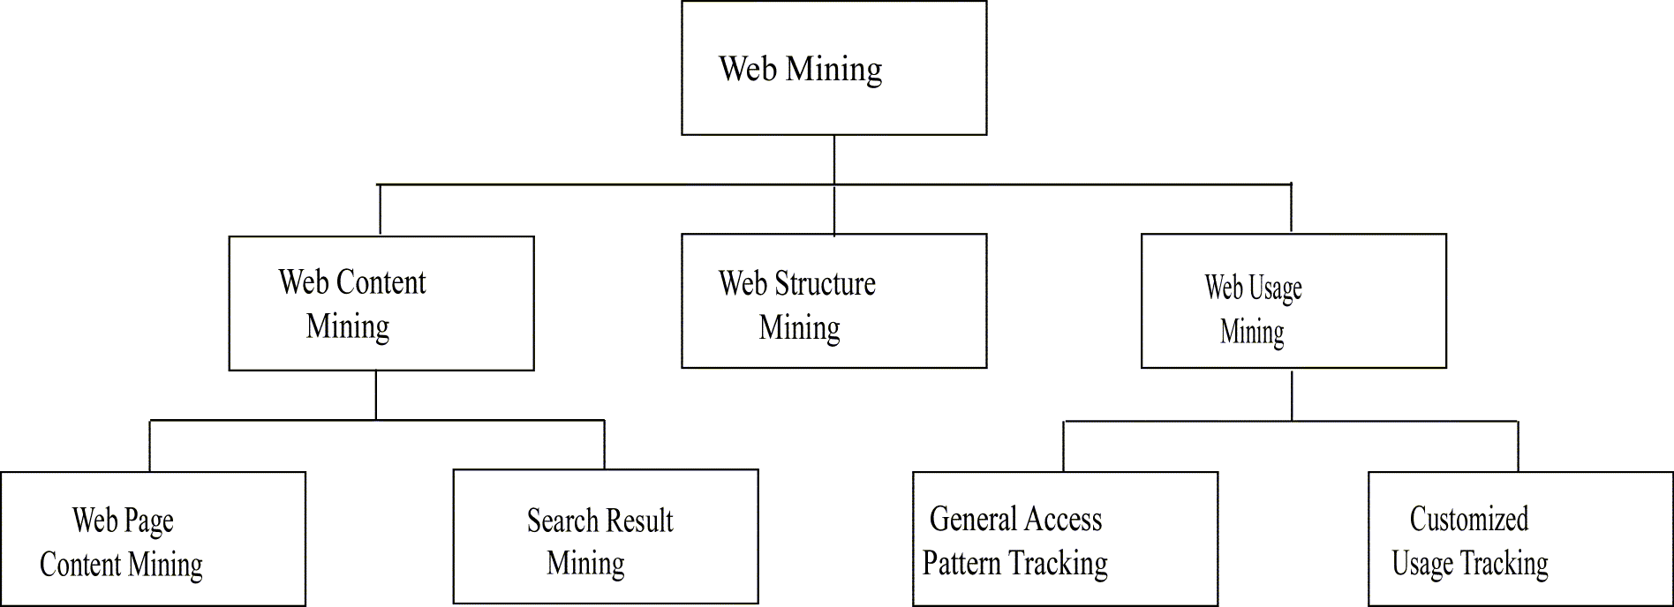
Modified from [zai01]
© Prentice Hall

Slide 16

Extends work of basic search engines
Search Engines
  IR application
  Keyword based
  Similarity between query and document
  Crawlers
  Indexing
  Profiles
  Link analysis
© Prentice Hall

Slide 17
Discovery of useful information from web contents / data / documents Web data contents: text, image, audio, video, metadata and hyperlinks.
Pre-processing data before web content mining: feature selection.
Post-processing data can reduce ambiguous searching results
© Prentice Hall

Slide 18
Web Page Content Mining: Mines the contents of documents directly.
Search Engine Mining: Improves on the content search of other tools like search engines.
Web Content Mining is related to data mining and text mining It is related to data mining because many data mining techniques can be applied in Web content mining
It is related to text mining because much of the web content is text.
© Prentice Hall

Slide 19

Robot (spider) traverses the hypertext sructure in the Web.
Collect information from visited pages
Used to construct indexes for search engines
Traditional Crawler – visits entire Web and replaces index
Periodic Crawler – visits portions of the Web and updates subset of index
Incremental Crawler – selectively searches the Web and incrementally modifies index
Focused Crawler – visits pages related to a particular subject
© Prentice Hall

Slide 20

Only visit links from a page if that page is determined to be relevant.
Classifier is static after learning phase.
Components:
  Classifier which assigns relevance score to each page based on crawl topic.
  Distiller to identify hub pages.
  Crawler visits pages to based on crawler and distiller scores.
© Prentice Hall

Slide 21
Classifier to related documents to topics.
Classifier also determines how useful outgoing links are.
Hub Pages contain links to many relevant pages. Must be visited even if not high relevance score.
© Prentice Hall

Slide 22

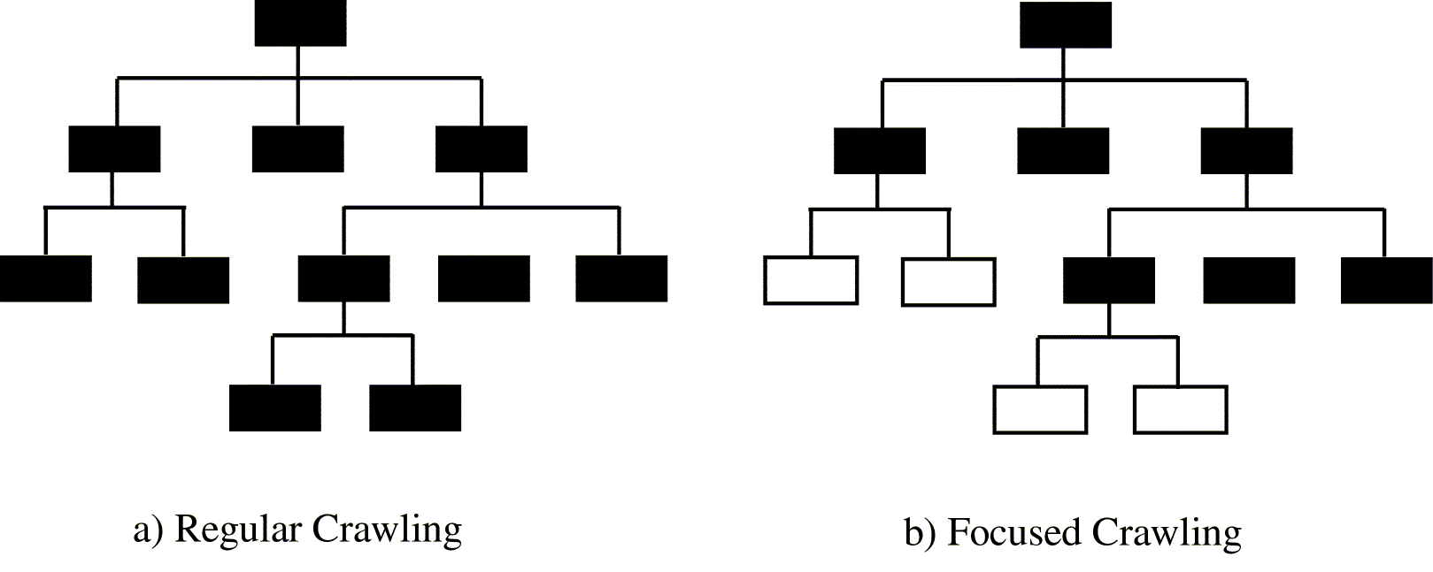
© Prentice Hall

Slide 23

Context Graph:
  Context graph created for each seed document
  Root is the seed document.
  Nodes at each level show documents with links to documents at next higher level.
  Updated during crawl itself .
.
© Prentice Hall

Slide 24
Approach:
  Construct context graph and classifiers using seed documents as training data.
  Perform crawling using classifiers and context graph created
© Prentice Hall

Slide 25

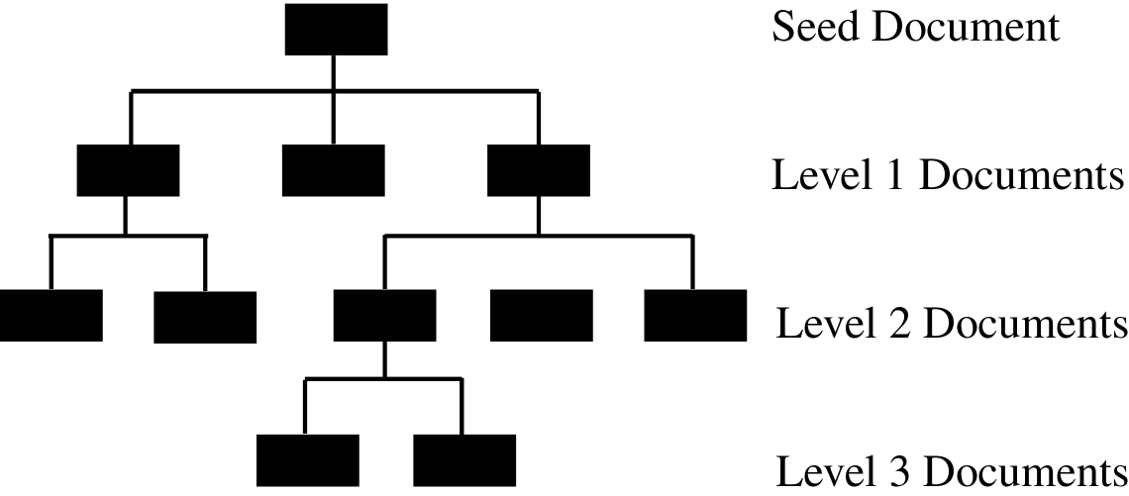
© Prentice Hall

Slide 26

Multiple Layered DataBase (MLDB) built on top of the Web.
Each layer of the database is more generalized (and smaller) and centralized than the one beneath it.
Upper layers of MLDB are structured and can be accessed with SQL type queries.
Translation tools convert Web documents to XML.
Extraction tools extract desired information to place in first layer of MLDB.
Higher levels contain more summarized data obtained through generalizations of the lower levels.
© Prentice Hall

Slide 27

A WebML is proposed to provide data mining operations on the MLDB.
WebML is an extension of DMQL.
A major feature of WebML are four primitive operations based on the use of concept hierarchies for the keywords.
  COVERS: one concept covers another if it is higher in the hierarchy.
  COVERED BY: This is the reverse of COVERS .
© Prentice Hall

Slide 28
  LIKE : The concept is a synonym.
  CLOSE TO : One concept is close to another if it is a sibling in the hierarchy.
Ex: The query finds all documents at the level of www.wngr.smu.edu that have a keyword that covers the keyword MINING.
  Select *
  FROM document in www.wngr.smu.edu \\
  WHERE ONE OF keywords COVERS “MINING”
© Prentice Hall

Slide 29

Web access or contents tuned to better fit the desires of each user.
Manual techniques identify user’s preferences based on profiles or demographics.
Collaborative filtering identifies preferences based on previously been given high ratings from similar users.
Content based filtering retrieves pages based on similarity between pages and user profiles.
© Prentice Hall

Slide 30

Mine structure (links, graph) of the Web
Techniques
  PageRank
  CLEVER
Create a model of the Web organization.
May be combined with content mining to more effectively retrieve important pages.
© Prentice Hall

Slide 31

Used by Google
Prioritize pages returned from search by looking at Web structure.
Importance of page is calculated based on number of pages which point to it – Backlinks.
A backlink is a link pointing to a page rather than pointing out from a page.
Weighting is used to provide more importance to backlinks coming form important pages.
© Prentice Hall

Slide 32

PR(p) = c (PR(1)/N₁ + … + PR(n)/N_{n})
  PR(i): PageRank for a page i which points to target page p.
  N_{i}: number of links coming out of page I
  c is a value between 0 and 1 and is used for mormalization.
© Prentice Hall

Slide 33

Identify authoritative and hub pages.
Authoritative Pages :
  Highly important pages.
  Best source for requested information.
Hub Pages :
  Contain links to highly important pages.
© Prentice Hall

Slide 34

Hyperlink-Induced Topic Search
Based on a set of keywords, find set of relevant pages – R.
Identify hub and authority pages for these.
  Expand R to a base set, B, of pages linked to or from R.
  Calculate weights for authorities and hubs.
Pages with highest ranks in R are returned.
© Prentice Hall

Slide 35

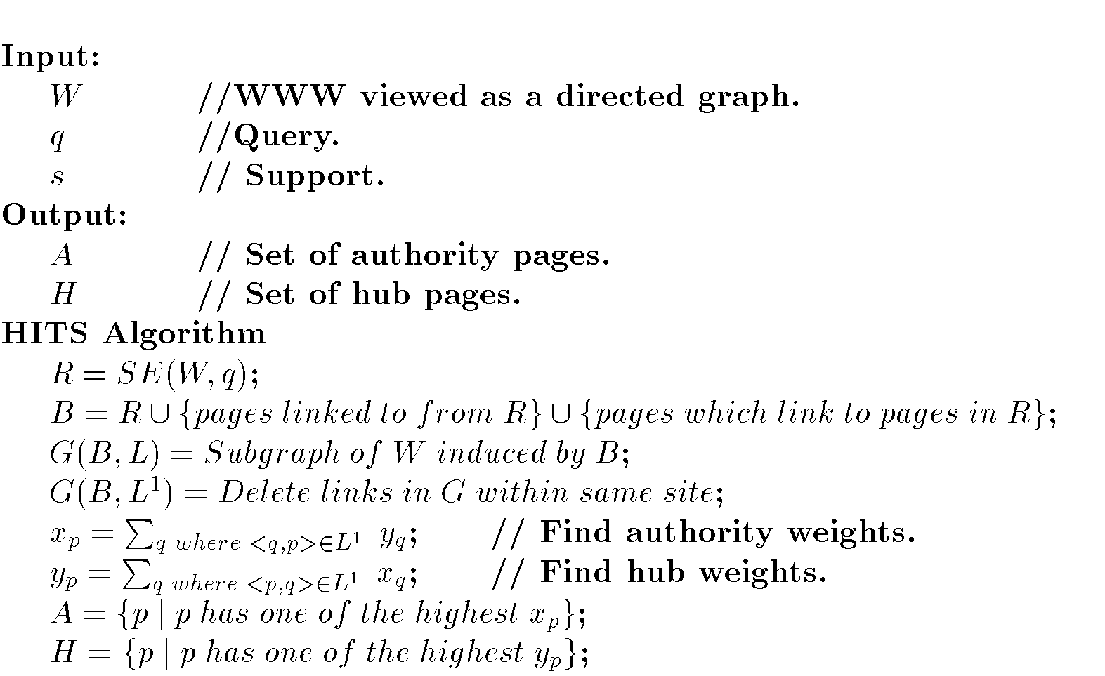
© Prentice Hall

Slide 36

Extends work of basic search engines
Search Engines
  IR application
  Keyword based
  Similarity between query and document
  Crawlers
  Indexing
  Profiles
  Link analysis
© Prentice Hall

Slide 37

Personalization
Improve structure of a site’s Web pages
Aid in caching and prediction of future page references
Improve design of individual pages
Improve effectiveness of e-commerce (sales and advertising)
© Prentice Hall

Slide 38

Preprocessing Web log
  Cleanse
  Remove extraneous information
  Sessionize
    Session: Sequence of pages referenced by one user at a sitting.
Pattern Discovery
  Count patterns that occur in sessions
  Pattern is sequence of pages references in session.
  Similar to association rules
    Transaction: session
    Itemset: pattern (or subset)
    Order is important
Pattern Analysis
© Prentice Hall

Slide 39

Web Mining:
  Content
  Structure
  Usage
Frequent patterns of sequential page references in Web searching.
Uses:
  Caching
  Clustering users
  Develop user profiles
  Identify important pages
© Prentice Hall

Slide 40

Identification of exact user not possible.
Exact sequence of pages referenced by a user not possible due to caching.
Session not well defined
Security, privacy, and legal issues
© Prentice Hall

Slide 41

Replace source IP address with unique but non-identifying ID.
Replace exact URL of pages referenced with unique but non-identifying ID.
Delete error records and records containing not page data (such as figures and code)
© Prentice Hall

Slide 42

Divide Web log into sessions.
Two common techniques:
  Number of consecutive page references from a source IP address occurring within a predefined time interval (e.g. 25 minutes).
  All consecutive page references from a source IP address where the interclick time is less than a predefined threshold.
© Prentice Hall

Slide 43

Keep track of patterns identified during Web usage mining process
Common techniques:
  Trie
  Suffix Tree
  Generalized Suffix Tree
  WAP Tree
© Prentice Hall

Slide 44

Trie:
  Rooted tree.
  Edges labeled which character (page) from pattern
  Path from root to leaf represents pattern.
  Tries are used to store strings for pattern matching application
© Prentice Hall

Slide 45

Suffix Tree:
  The compressed Trie is called a suffix Tree.
    Each internal node except the root has at least two children.
    Each edge represents a nonempty subsequence.
    The subsequences represented by sibling edges begin with different symbols.
    Efficient to find any subsequence in a sequence.
    Common subsequences among multiple sequences can also be found.
© Prentice Hall

Slide 46

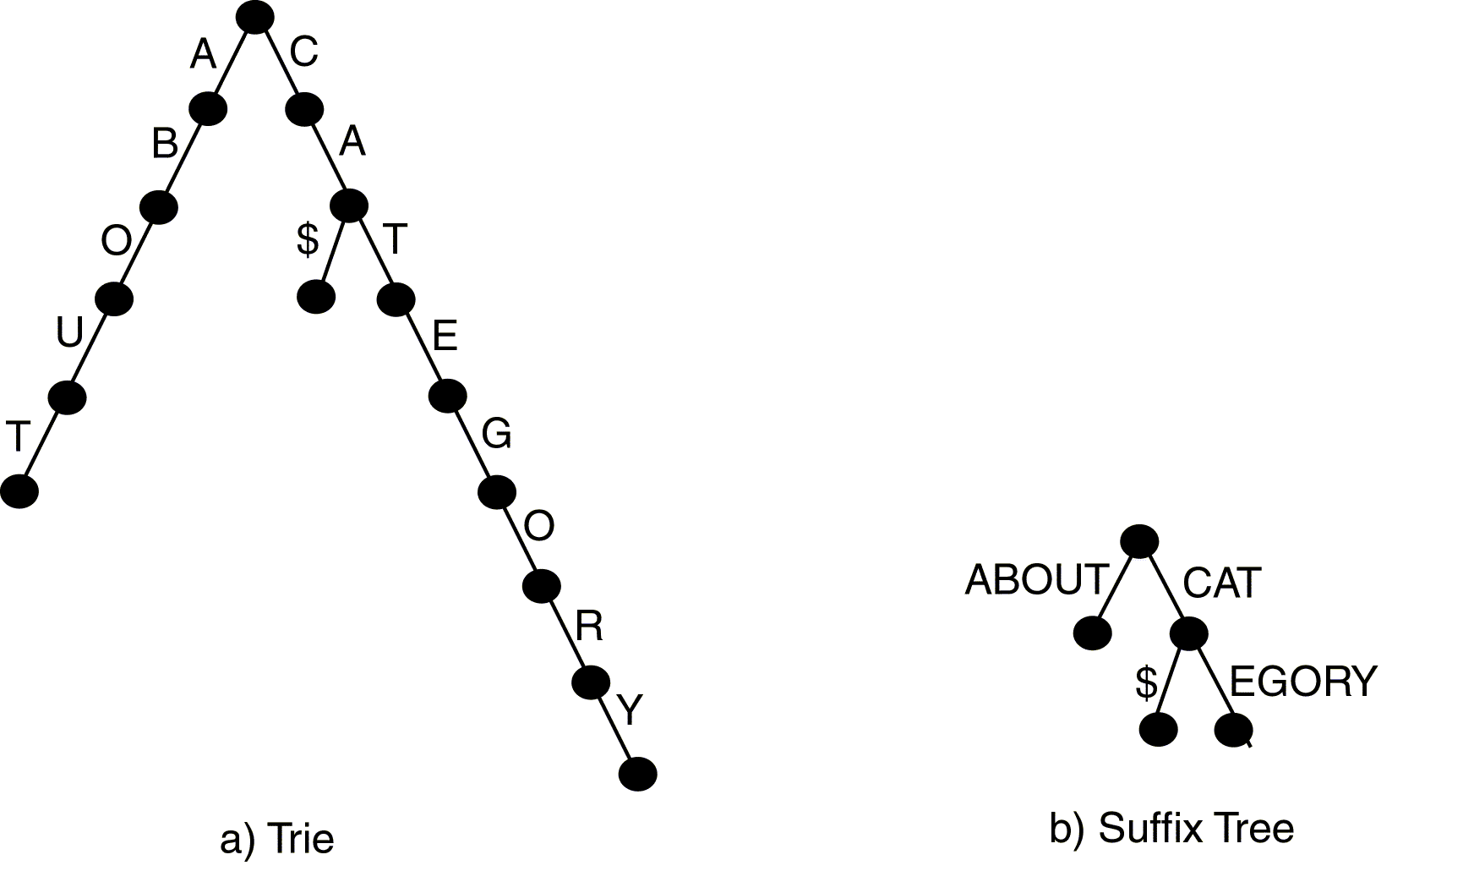
© Prentice Hall

Slide 47

Suffix tree for multiple sessions.
Contains patterns from all sessions.
Maintains count of frequency of occurrence of a pattern in the node.
WAP Tree(Web Access Pattern):
  Compressed version of generalized suffix tree.
  Each node in the tree is associated with an event(A page found at a particular time by a user)
© Prentice Hall

Slide 48

Algorithms have been developed to discover different types of patterns.
Properties:
  Ordered – Characters (pages) must occur in the exact order in the original session.
  Duplicates – Duplicate characters are allowed in the pattern. (design of a set of pages)
  Consecutive – All characters in pattern must occur consecutive in given session.(prefetching & caching)
  Maximal – Not subsequence of another pattern.(no of meaningful patterns)
© Prentice Hall

Slide 49

Association Rules
  None of the properties hold
Episodes
  Only ordering holds
Sequential Patterns
  Ordered and maximal
Forward Sequences
  Ordered, consecutive, and maximal
Maximal Frequent Sequences
  All properties hold
© Prentice Hall

Slide 50

Partially ordered set of pages
Serial episode – totally ordered with time constraint
Parallel episode – partial ordered with time constraint
General episode – partial ordered with no time constraint
© Prentice Hall

Slide 51

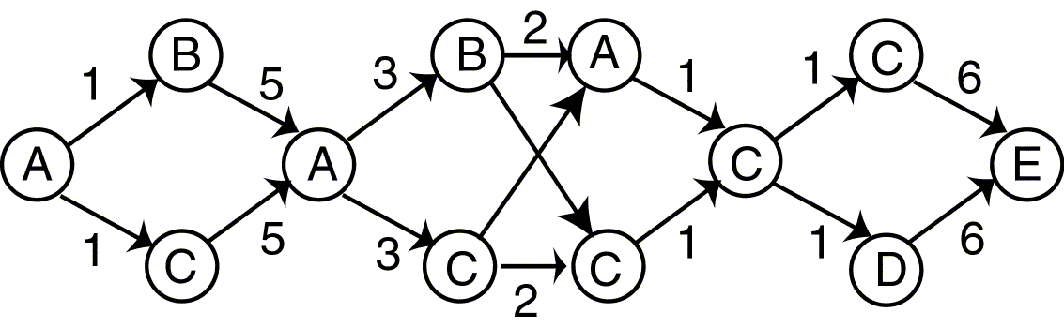
<(A,1),(B,2),(C,2),(A,7),(C,10),(B,10),(C,12),(A,12)
(C,13),(D,14),(C,14),(E,20)>
Arcs are used to represent temporal ordering.
Starting at the first event and looking at the
maximum window size of 3, we have 2 serial
episodes. AC and AB. B and C occur as parallel
episodes.
Starting at time 12 , Serial Episodes: ACD, ACC,
CCC, CCD, AC, CC, CC, CD. Two Parallel episodes
are A and C and C and D
© Prentice Hall

Slide 52

Goal: Provide an introduction to some spatial mining techniques.
Introduction
Spatial Data Overview
Spatial Data Mining Primitives
Generalization/Specialization
Spatial Rules
Spatial Classification
Spatial Clustering
© Prentice Hall

Slide 53
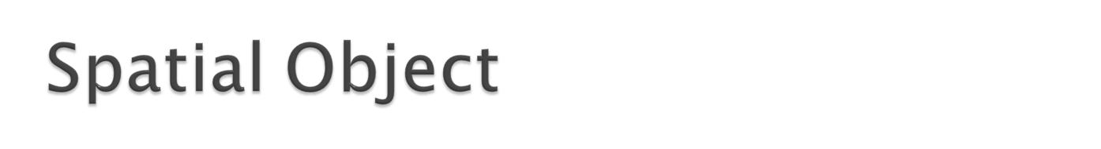
Contains both spatial and nonspatial attributes.
Must have a location type attributes:
  Latitude/longitude
  Zip code
  Street address
May retrieve object using either (or both) spatial or nonspatial attributes.
© Prentice Hall

Slide 54

Geology
GIS Systems
Environmental Science
Agriculture
Medicine
Robotics
May involved both spatial and temporal aspects
© Prentice Hall

Slide 55

Spatial selection may involve specialized selection comparison operations:
  Near
  North, South, East, West
  Contained in
  Overlap/intersect
Region (Range) Query – find objects that intersect a given region.
Nearest Neighbor Query – find object close to identified object.
Distance Scan – find object within a certain distance of an identified object where distance is made increasingly larger.
© Prentice Hall

Slide 56

Data structures designed specifically to store or index spatial data.
Often based on B-tree or Binary Search Tree
Cluster data on disk basked on geographic location.
May represent complex spatial structure by placing the spatial object in a containing structure of a specific geographic shape.
Techniques:
  Quad Tree
  R-Tree
  k-D Tree
© Prentice Hall

Slide 57

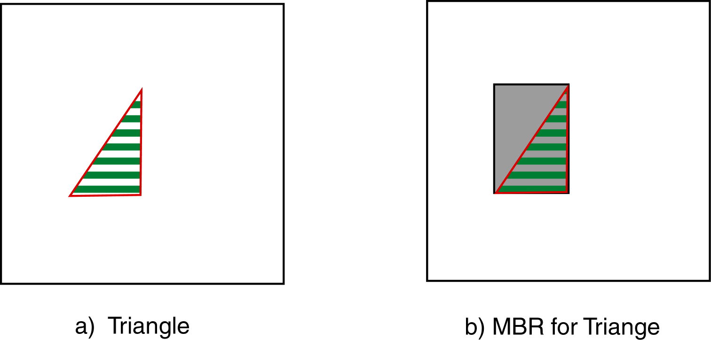
Minimum Bounding Rectangle
Smallest rectangle that completely contains the object
© Prentice Hall

Slide 58

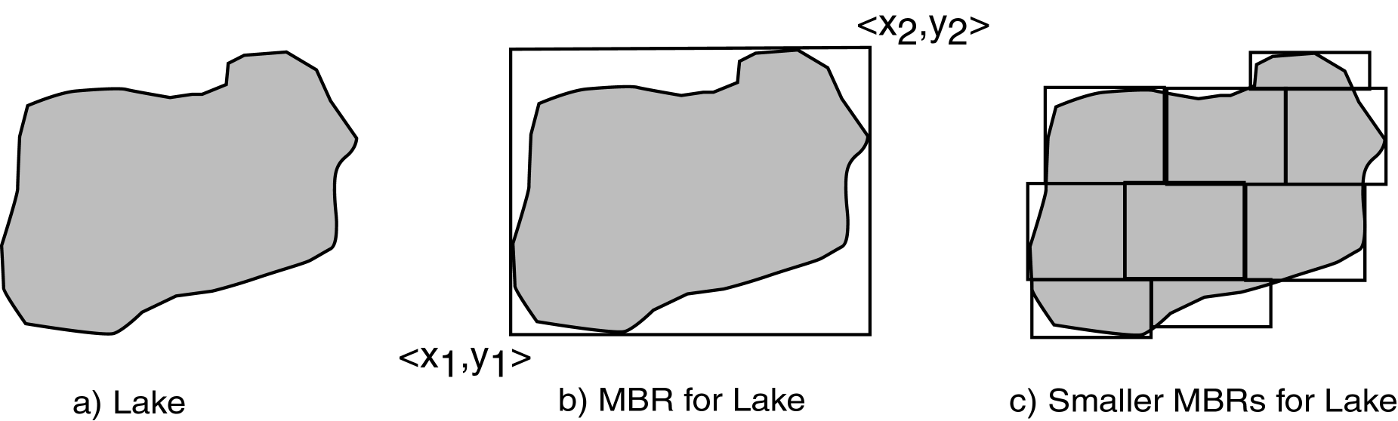
© Prentice Hall

Slide 59

Disjoint
Overlaps or Intersects
Equals
Covered by or inside or contained in
Covers or contains
© Prentice Hall

Slide 60

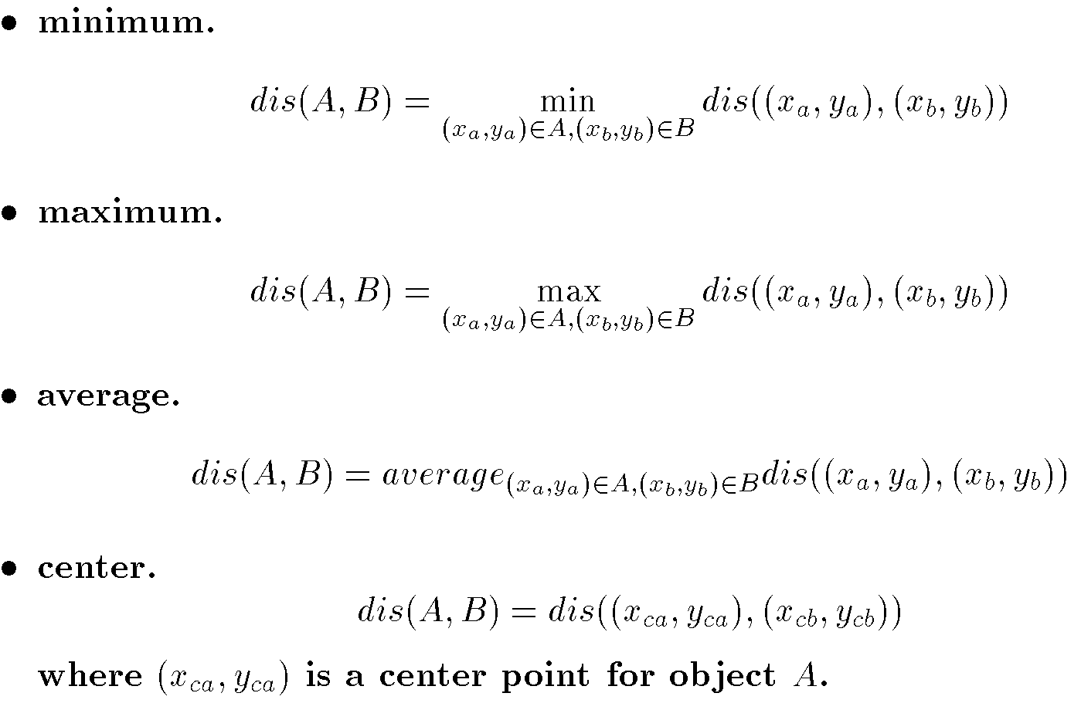
Euclidean
Manhattan
Extensions:
© Prentice Hall

Slide 61
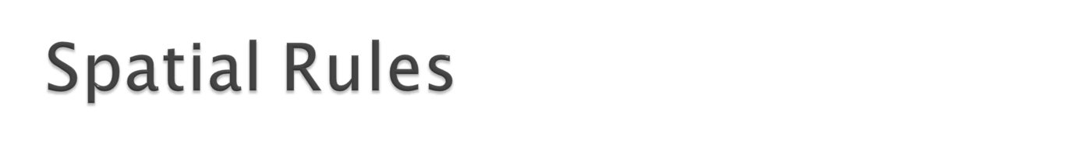
Characteristic Rule
The average family income in Dallas is $50,000.
Discriminant Rule
The average family income in Dallas is $50,000, while in Plano the average income is $75,000.
Association Rule
The average family income in Dallas for families living near White Rock Lake is $100,000.
© Prentice Hall

Slide 62
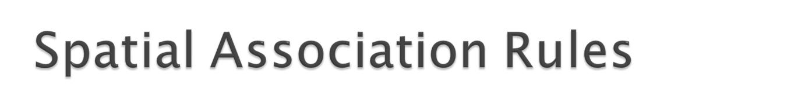
Either antecedent or consequent must contain spatial predicates.
View underlying database as set of spatial objects.
© Prentice Hall

Slide 63
Non spatial antecedent and spatial consequent: all elementary schools are located close t o single family housing developments.
Spatial antecedent and non-spatial consequent:
© Prentice Hall

Slide 64
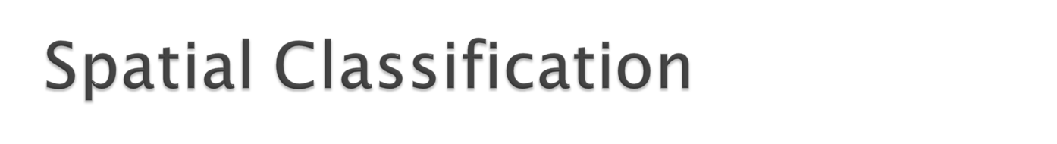
Partition spatial objects
May use nonspatial attributes and/or spatial attributes
© Prentice Hall

Slide 65

Neighborhood Graph
  Nodes – objects
  Edges – connects neighbors
Definition of neighborhood varies
ID3 considers nonspatial attributes of all objects in a neighborhood (not just one) for classification.
© Prentice Hall

Slide 66
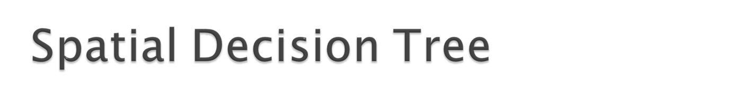
Approach similar to that used for spatial association rules.
Spatial objects can be described based on objects close to them – Buffer.
Description of class based on aggregation of nearby objects.
© Prentice Hall

Slide 67
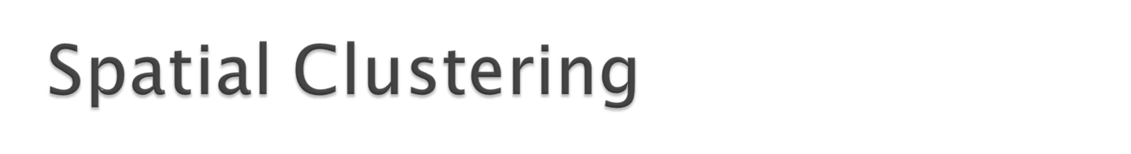
Detect clusters of irregular shapes
Use of centroids and simple distance approaches may not work well.
Clusters should be independent of order of input.
© Prentice Hall

Slide 68

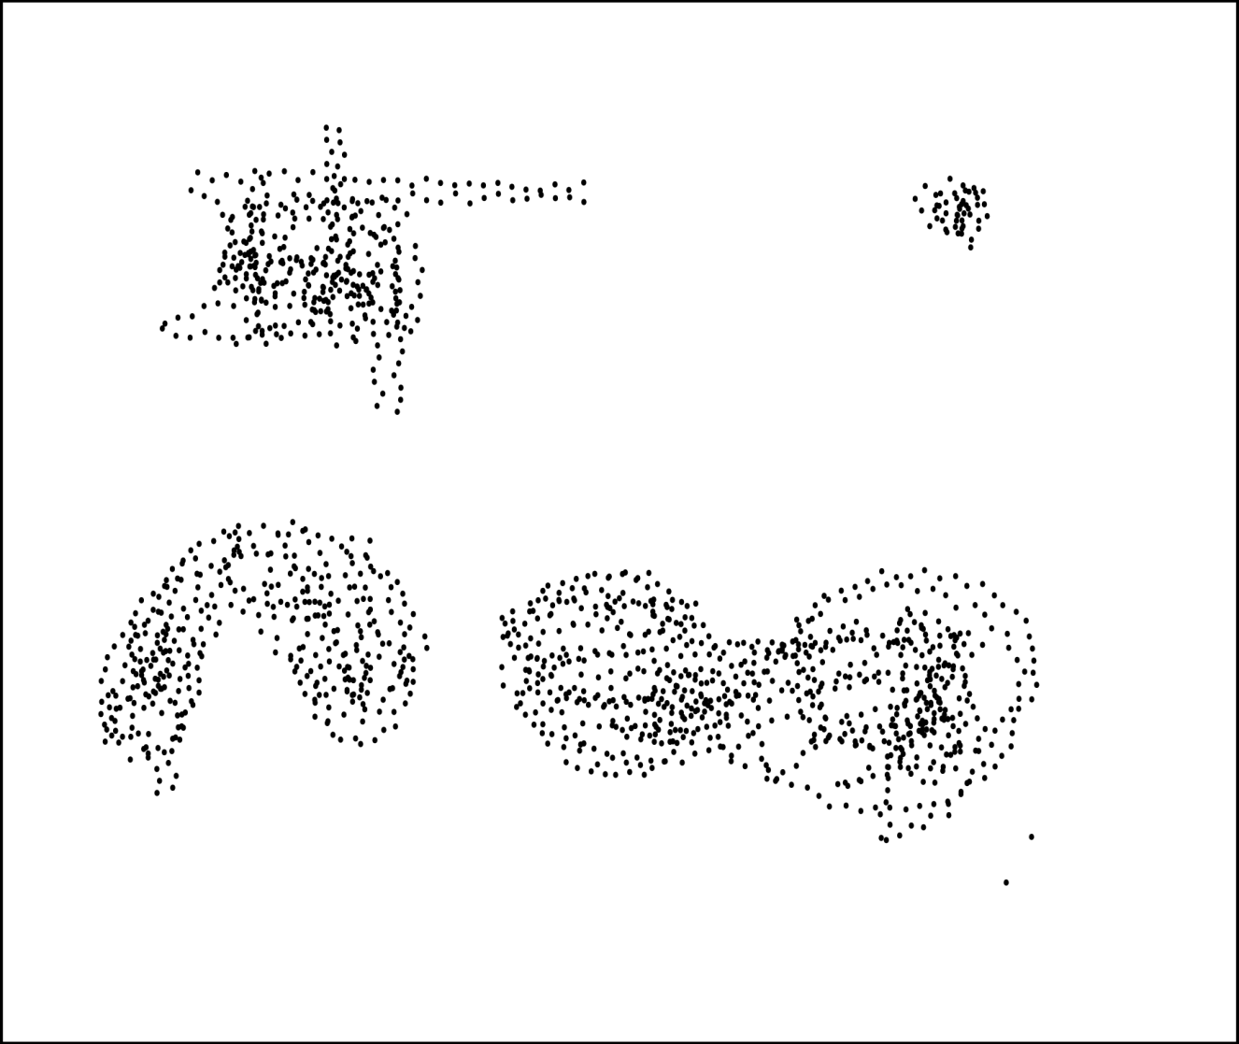
© Prentice Hall

Slide 69

Remove main memory assumption of CLARANS.
Use spatial index techniques.
Use sampling and R*-tree to identify central objects.
Change cost calculations by reducing the number of objects examined.
Voronoi Diagram
© Prentice Hall

Slide 70

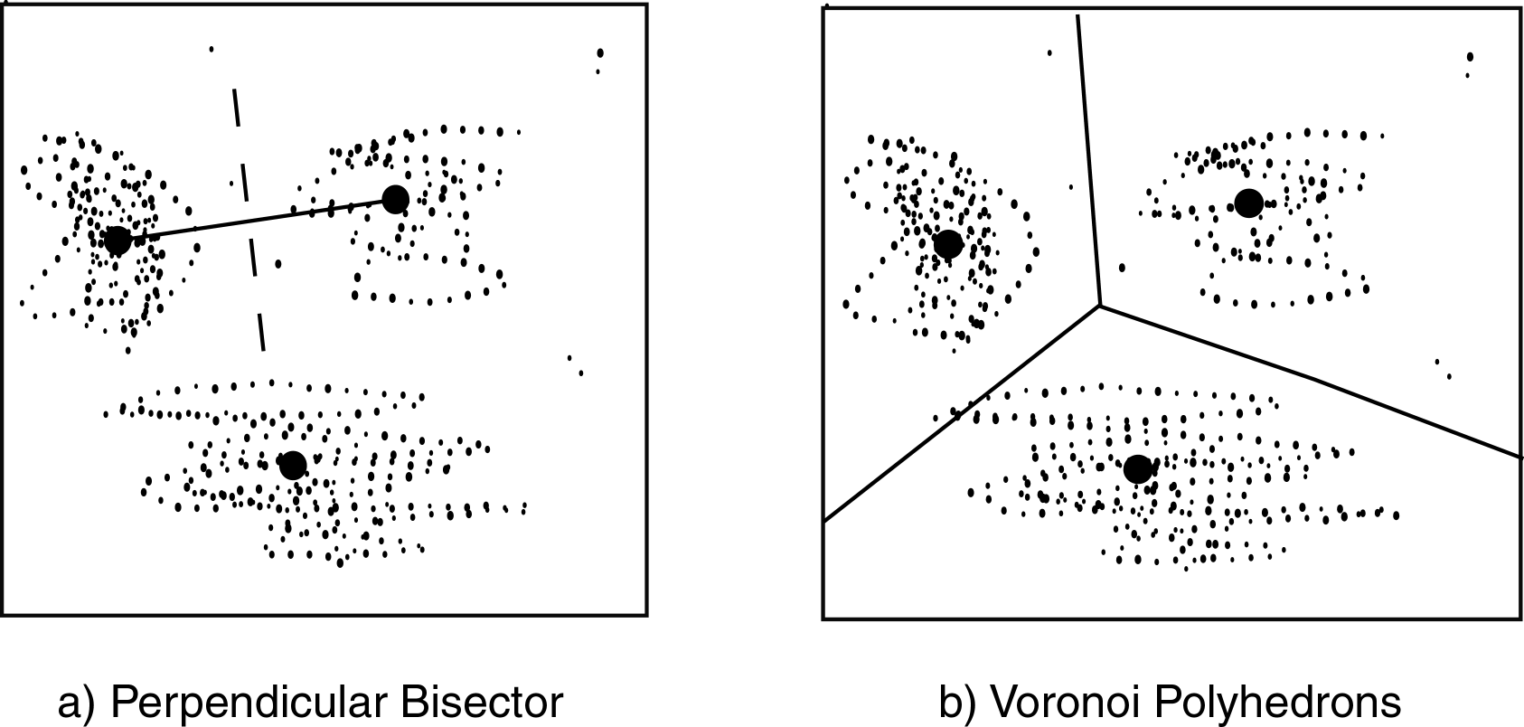
© Prentice Hall

Slide 71

Spatial Dominant
First clusters spatial components using CLARANS
Then iteratively replaces medoids, but limits number of pairs to be searched.
Uses generalization
Uses a learning to to derive description of cluster.
© Prentice Hall

Slide 72

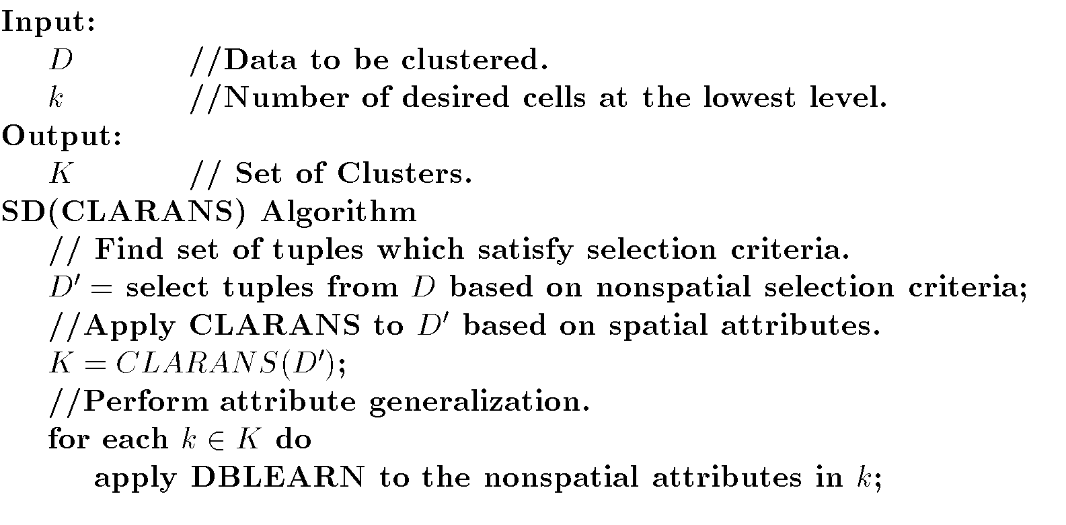
© Prentice Hall

Slide 73

Extension of DBSCAN
Distribution Based Clustering of LArge Spatial Databases
Assumes items in cluster are uniformly distributed.
Identifies distribution satisfied by distances between nearest neighbors.
Objects added if distribution is uniform.
© Prentice Hall

Slide 74

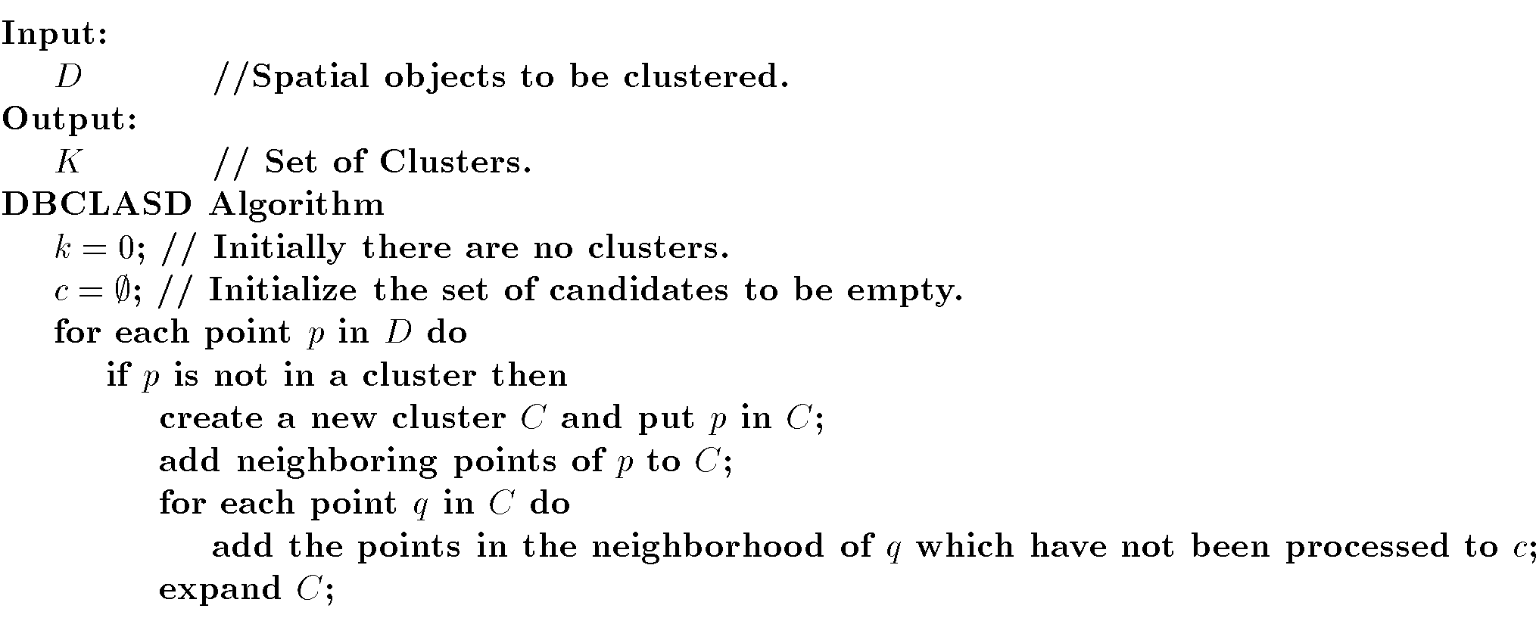
© Prentice Hall

Slide 75

Aggregate Proximity – measure of how close a cluster is to a feature.
Aggregate proximity relationship finds the k closest features to a cluster.
CRH Algorithm – uses different shapes:
  Encompassing Circle
  Isothetic Rectangle
  Convex Hull
© Prentice Hall

Slide 76

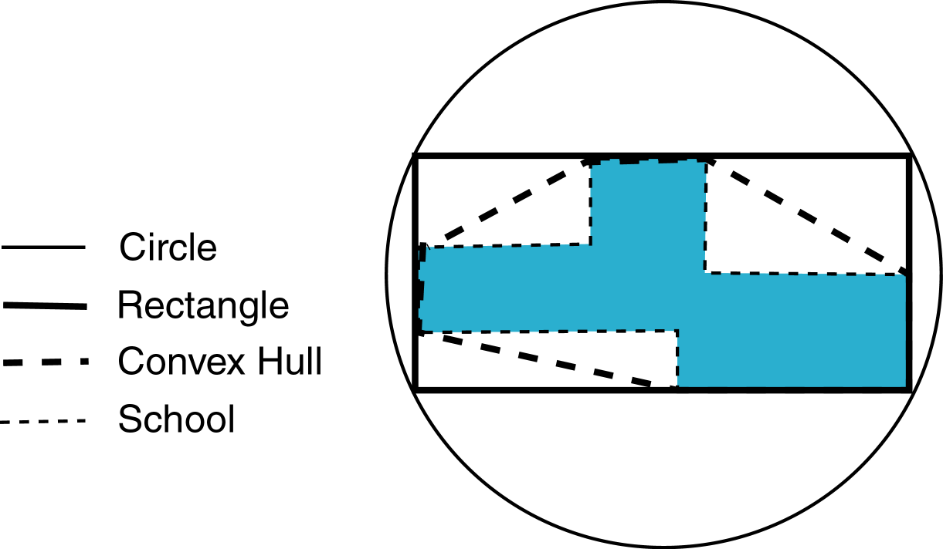
© Prentice Hall

Slide 77

Goal: Examine some temporal data mining issues and approaches.
Introduction
Modeling Temporal Events
Time Series
Pattern Detection
Sequences
Temporal Association Rules
© Prentice Hall

Slide 78

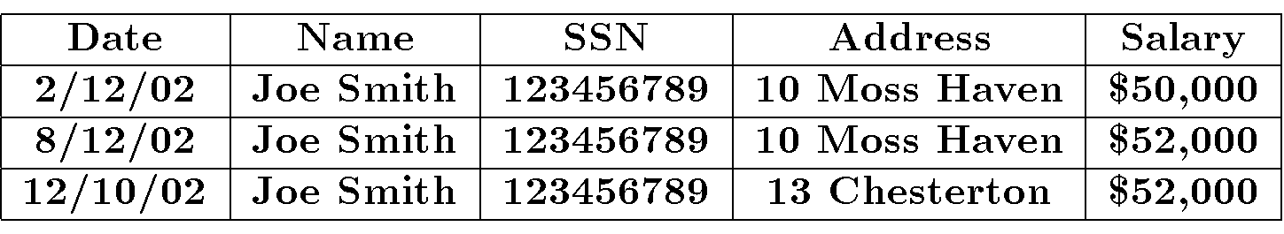
Snapshot – Traditional database
Temporal – Multiple time points
Ex:
© Prentice Hall

Slide 79

Query
Database
Intersection Query
Inclusion Query
Containment Query
Point Query – Tuple retrieved is valid at a particular point in time.
t_{s}^{q} t_{e}^{q}
t_{s}^{d} t_{e}^{d}
t_{s}^{q} t_{e}^{q}
t_{s}^{d} t_{e}^{d}
t_{s}^{q} t_{e}^{q}
t_{s}^{d} t_{e}^{d}
t_{s}^{d} t_{e}^{d}
t_{s}^{q} t_{e}^{q}
© Prentice Hall

Slide 80

Snapshot – No temporal support
Transaction Time – Supports time when transaction inserted data
  Timestamp
  Range
Valid Time – Supports time range when data values are valid
Bitemporal – Supports both transaction and valid time.
© Prentice Hall

Slide 81

Techniques to model temporal events.
Often based on earlier approaches
Finite State Recognizer (Machine) (FSR)
  Each event recognizes one character
  Temporal ordering indicated by arcs
  May recognize a sequence
  Require precisely defined transitions between states
Approaches
  Markov Model
  Hidden Markov Model
  Recurrent Neural Network
© Prentice Hall

Slide 82

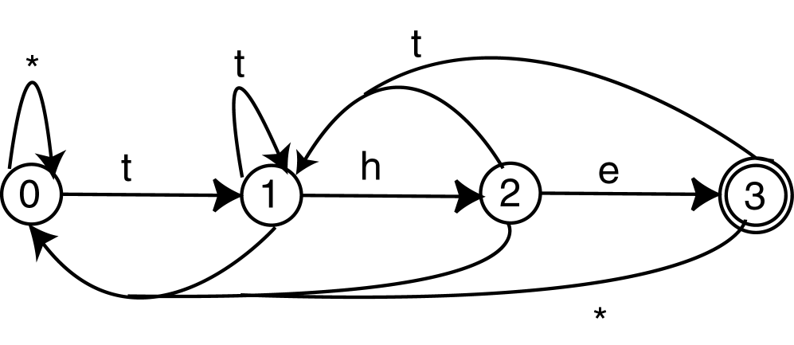
© Prentice Hall

Slide 83

Directed graph
  Vertices represent states
  Arcs show transitions between states
  Arc has probability of transition
  At any time one state is designated as current state.
Markov Property – Given a current state, the transition probability is independent of any previous states.
Applications: speech recognition, natural language processing
© Prentice Hall

Slide 84

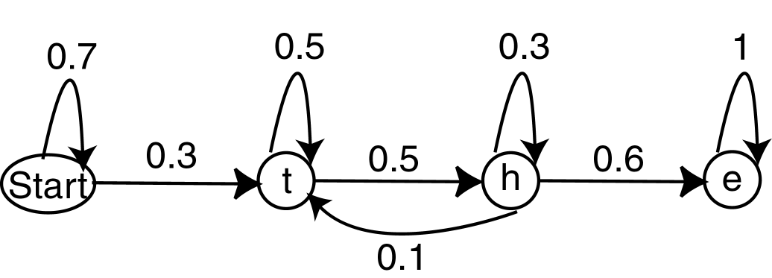
© Prentice Hall

Slide 85

Like HMM, but states need not correspond to observable states.
HMM models process that produces as output a sequence of observable symbols.
HMM will actually output these symbols.
Associated with each node is the probability of the observation of an event.
Train HMM to recognize a sequence.
Transition and observation probabilities learned from training set.
© Prentice Hall

Slide 86

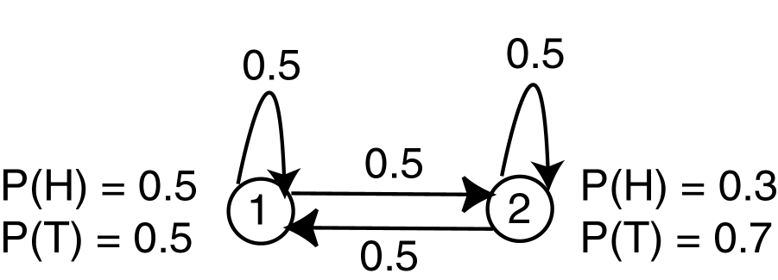
Modified from [RJ86]
© Prentice Hall

Slide 87

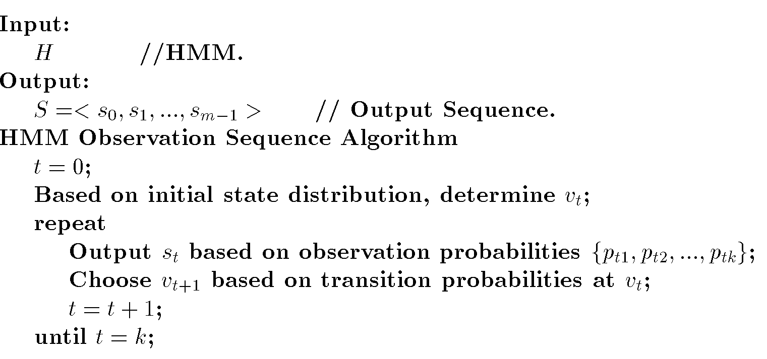
© Prentice Hall

Slide 88

Given a sequence of events and an HMM, what is the probability that the HMM produced the sequence?
Given a sequence and an HMM, what is the most likely state sequence which produced this sequence?
© Prentice Hall

Slide 89

Extension to basic NN
Neuron can obtian input form any other neuron (including output layer).
Can be used for both recognition and prediction applications.
Time to produce output unknown
Temporal aspect added by backlinks.
© Prentice Hall

Slide 90

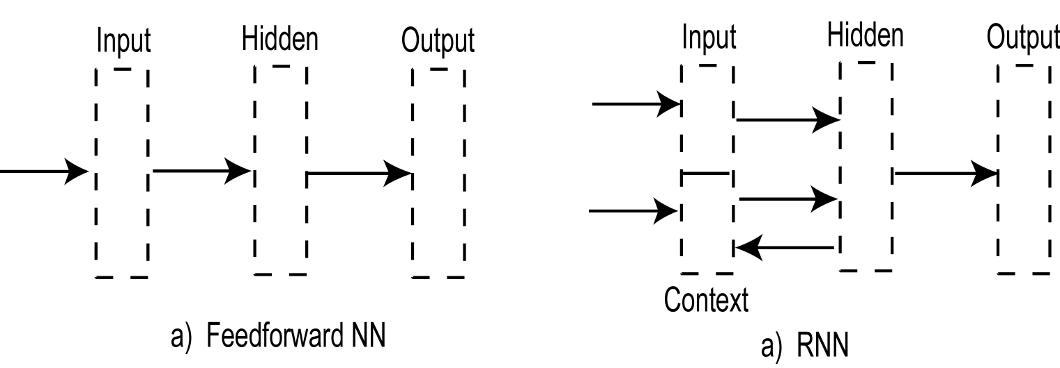
© Prentice Hall

Slide 91

Set of attribute values over time
Time Series Analysis – finding patterns in the values.
  Trends
  Cycles
  Seasonal
  Outliers
© Prentice Hall

Slide 92

Smoothing – Moving average of attribute values.
Autocorrelation – relationships between different subseries
  Yearly, seasonal
  Lag – Time difference between related items.
  Correlation Coefficient r
© Prentice Hall

Slide 93

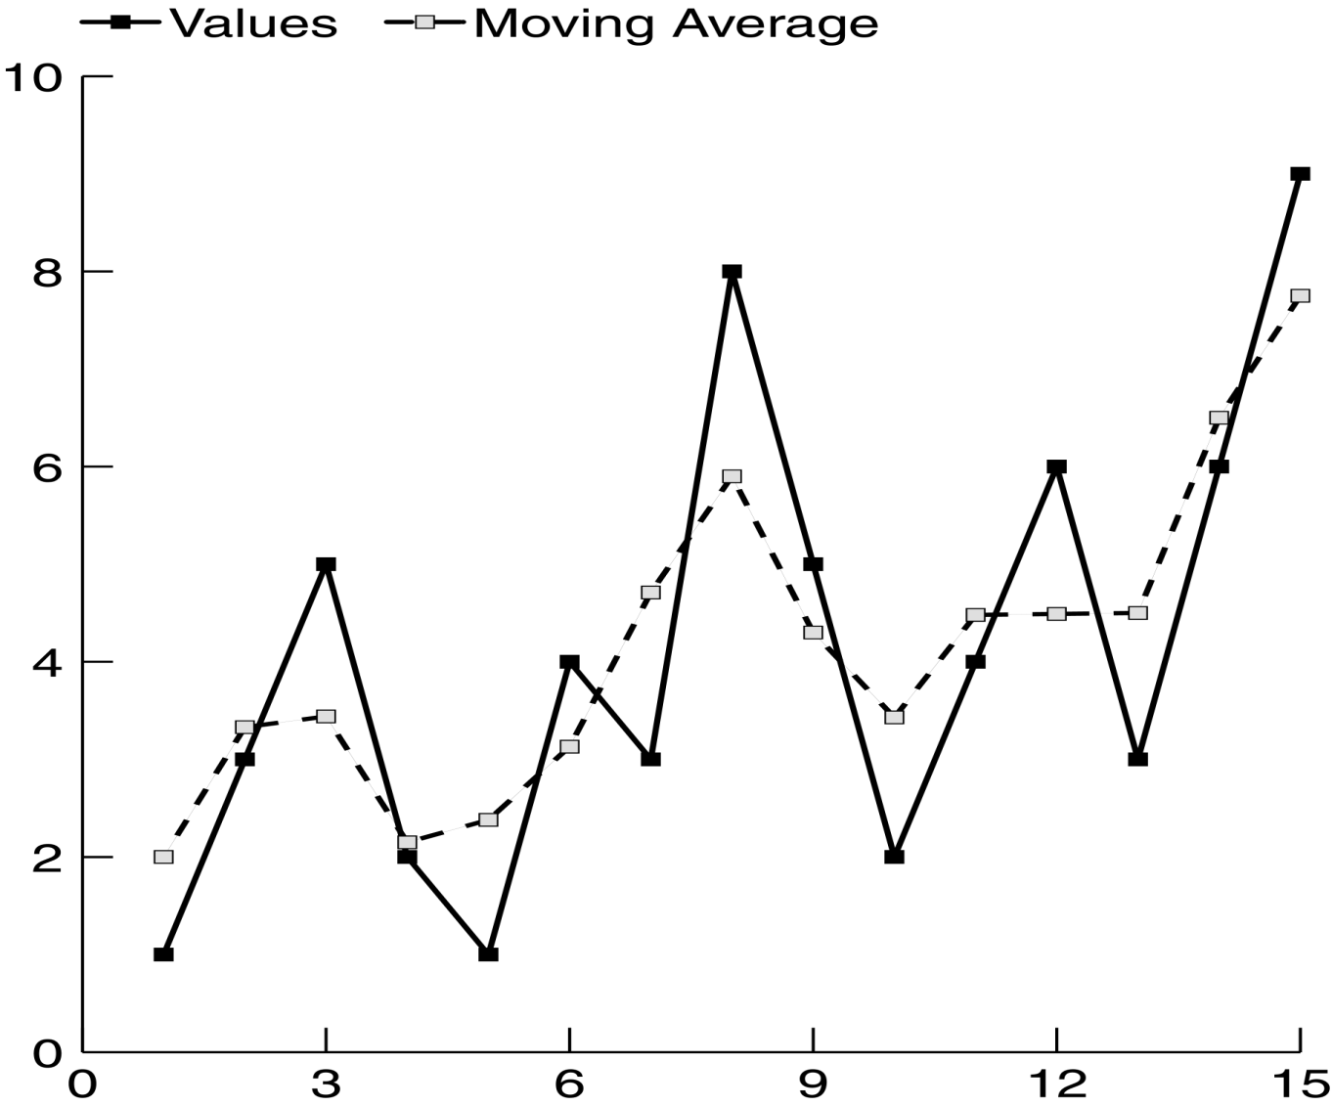
© Prentice Hall

Slide 94

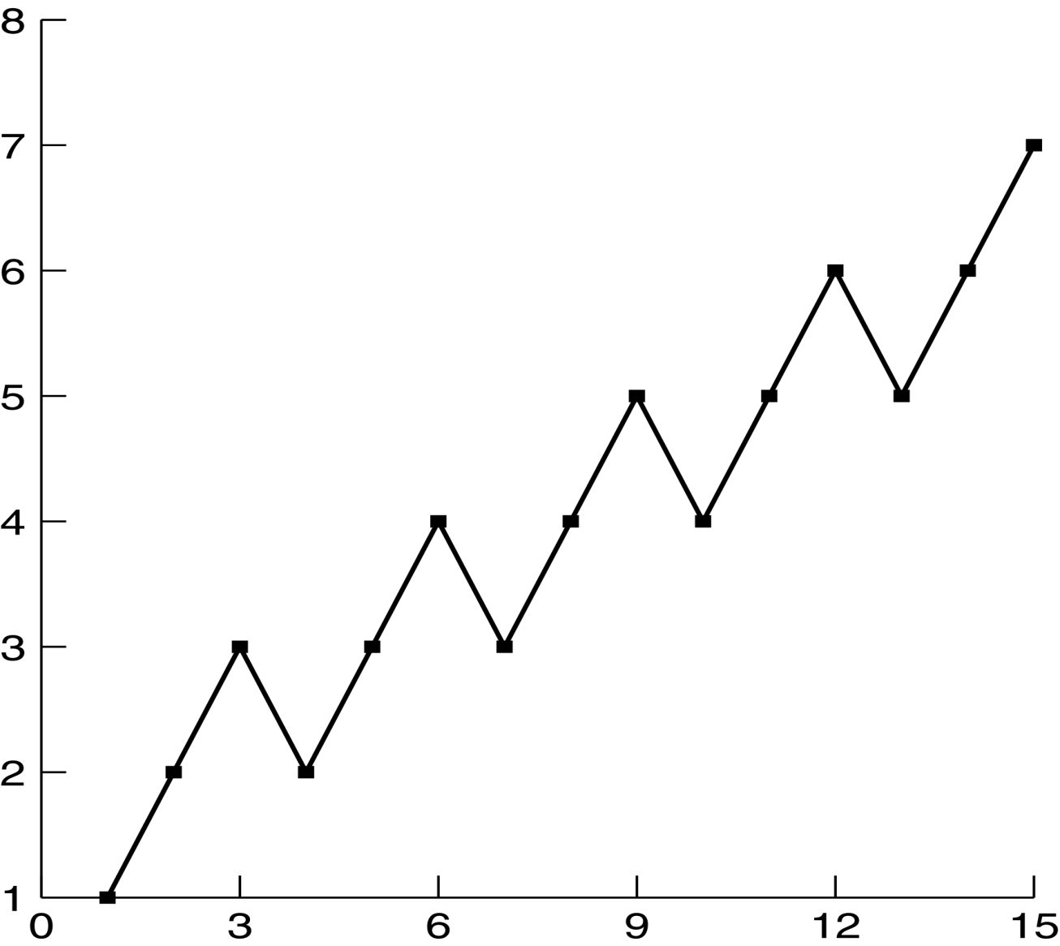
© Prentice Hall

Slide 95

Determine similarity between a target pattern, X, and sequence, Y: sim(X,Y)
Similar to Web usage mining
Similar to earlier word processing and spelling corrector applications.
Issues:
  Length
  Scale
  Gaps
  Outliers
  Baseline
© Prentice Hall

Slide 96

Find longest subseries they have in common.
Ex:
  X = <10,5,6,9,22,15,4,2>
  Y = <6,9,10,5,6,22,15,4,2>
  Output: <22,15,4,2>
  Sim(X,Y) = l/n = 4/9
© Prentice Hall

Slide 97
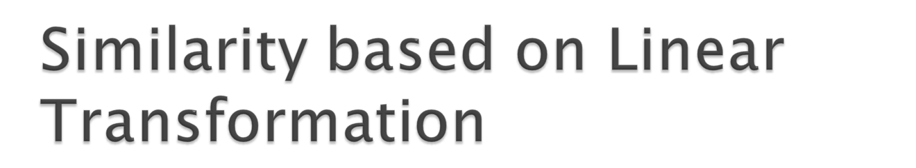
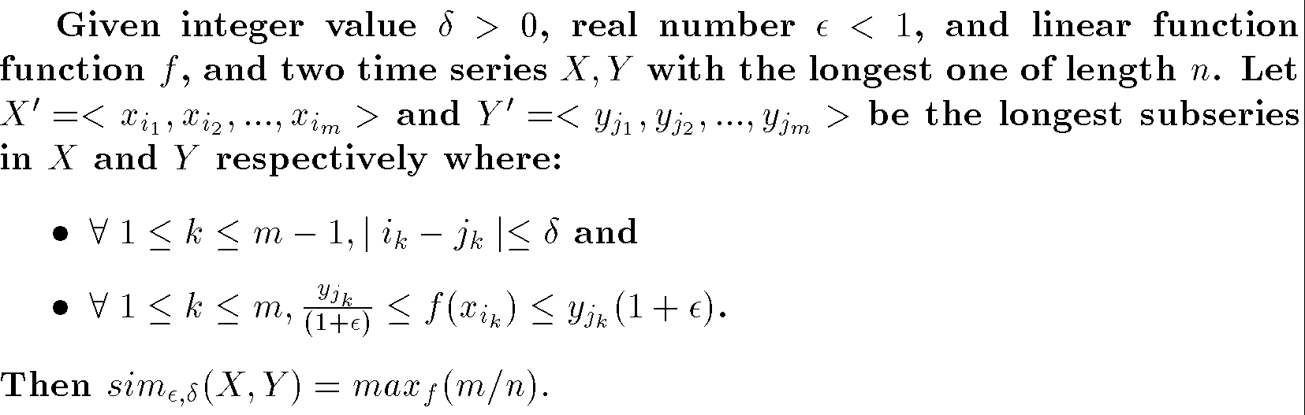
Linear transformation function f
  Convert a value form one series to a value in the second
ε_{f} – tolerated difference in results
δ – time value difference allowed
© Prentice Hall

Slide 98

Predict future value for time series
Regression may not be sufficient
Statistical Techniques
  ARMA
  ARIMA
NN
© Prentice Hall

Slide 99

Identify patterns of behavior in time series
Speech recognition, signal processing
FSR, MM, HMM
© Prentice Hall

Slide 100

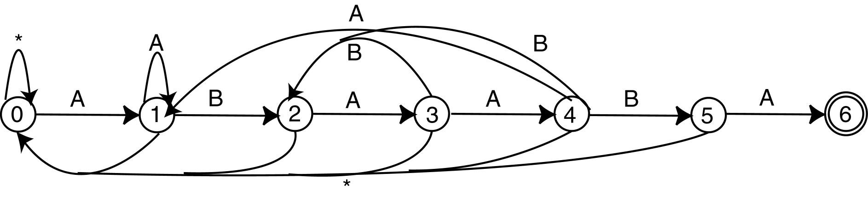
Find given pattern in sequence
Knuth-Morris-Pratt: Construct FSM
Boyer-Moore: Construct FSM
© Prentice Hall

Slide 101

Cost to convert one to the other
Transformations
  Match: Current characters in both strings are the same
  Delete: Delete current character in input string
  Insert: Insert current character in target string into string
© Prentice Hall

Slide 102

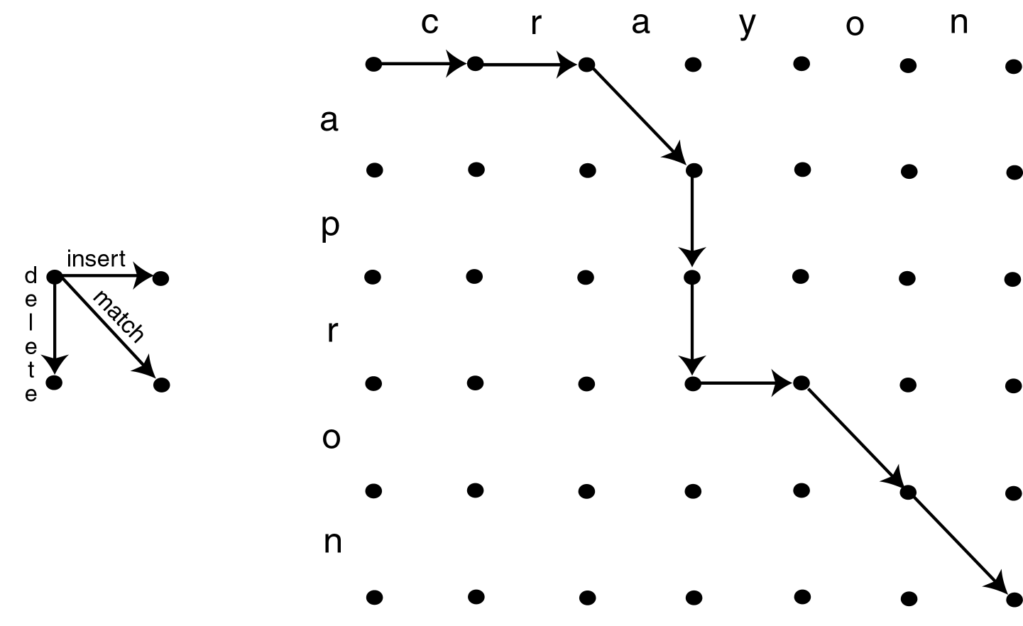
© Prentice Hall

Slide 103

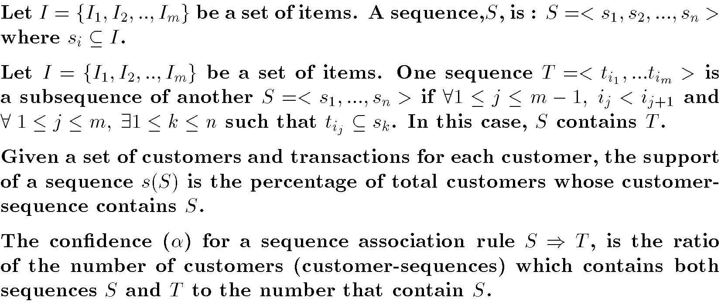
© Prentice Hall

Slide 104

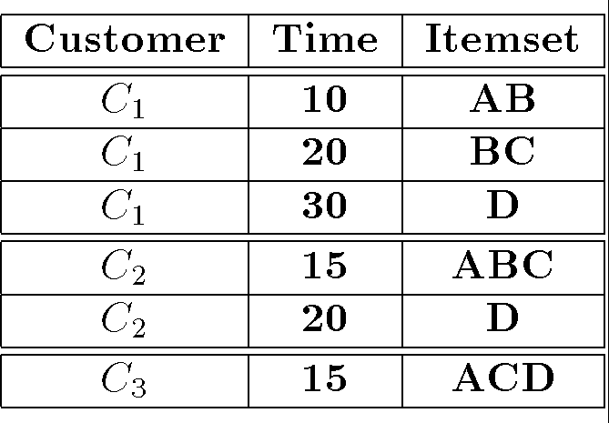
Purchases made by customers
s(<{A},{C}>) = 1/3
s(<{A},{D}>) = 2/3
s(<{B,C},{D}>) = 2/3
© Prentice Hall

Slide 105

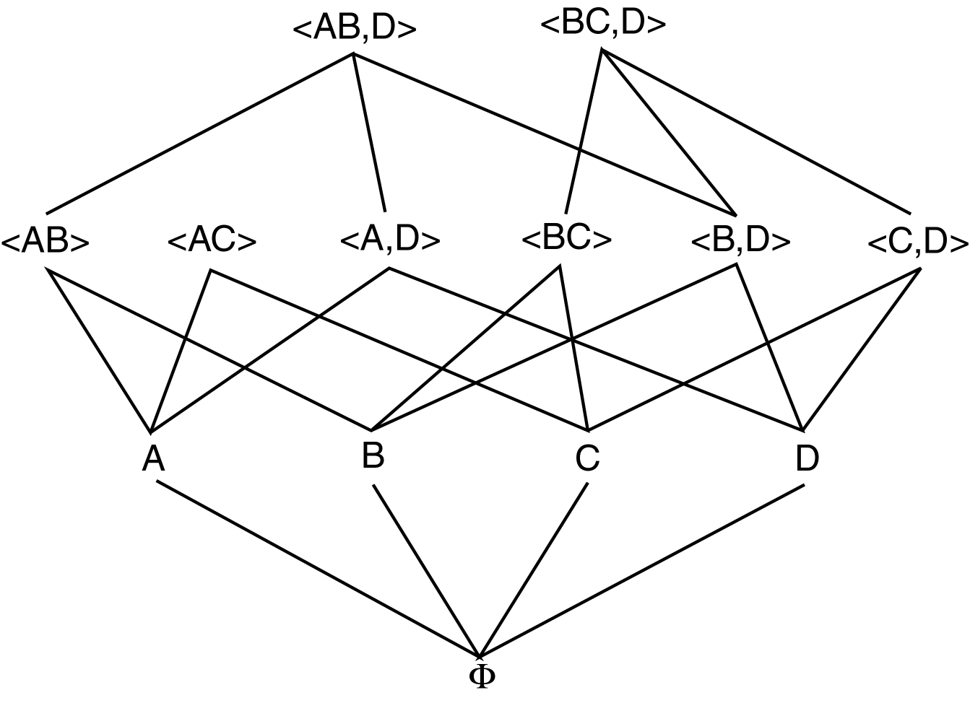
© Prentice Hall

Slide 106

Sequential Pattern Discovery using Equivalence classes
Identifies patterns by traversing lattice in a top down manner.
Divides lattice into equivalent classes and searches each separately.
ID-List: Associates customers and transactions with each item.
© Prentice Hall

Slide 107

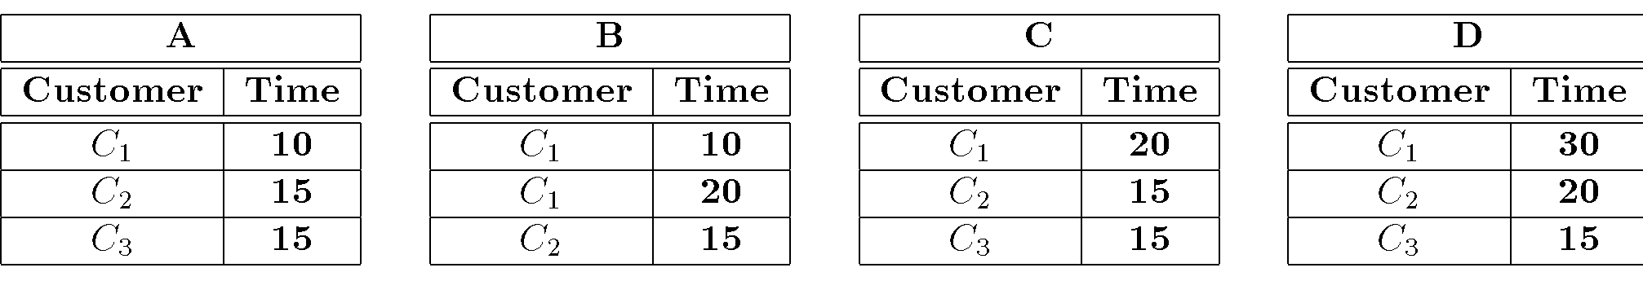
ID-List for Sequences of length 1:
Count for <{A}> is 3
Count for <{A},{D}> is 2
© Prentice Hall

Slide 108

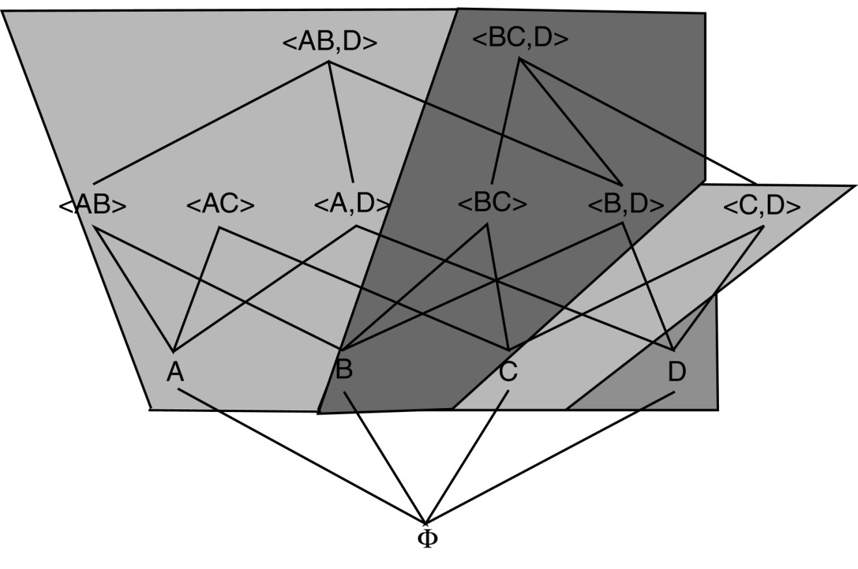
© Prentice Hall

Slide 109

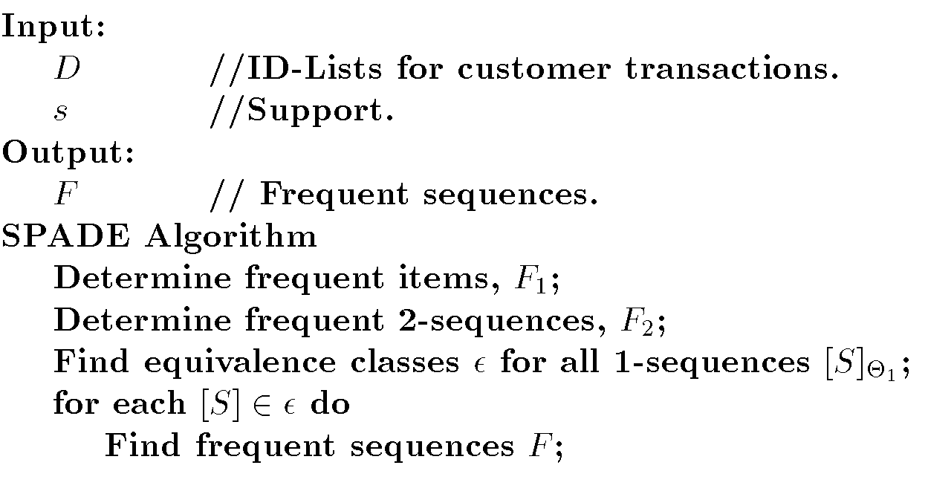
© Prentice Hall

Slide 110

Transaction has time:
  <TID,CID,I₁,I₂, …, I_{m},t_{s},t_{e}>
[t_{s},t_{e}] is range of time the transaction is active.
Types:
  Inter-transaction rules
  Episode rules
  Trend dependencies
  Sequence association rules
  Calendric association rules
© Prentice Hall

Slide 111

Intra-transaction association rules
  Traditional association Rules
Inter-transaction association rules
  Rules across transactions
  Sliding window – How far apart (time or number of transactions) to look for related itemsets.
© Prentice Hall

Slide 112

Association rules applied to sequences of events.
Episode – set of event predicates and partial ordering on them
© Prentice Hall

Slide 113

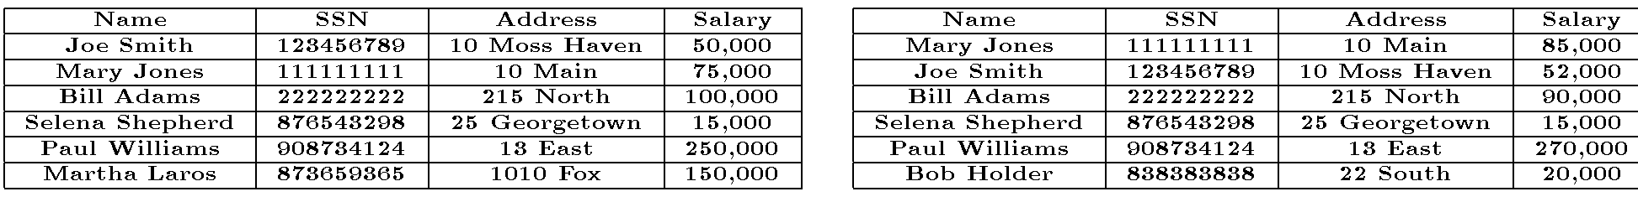
Association rules across two database states based on time.
Ex: (SSN,=) ⇒ (Salary, ≤)
      Confidence=4/5
      Support=4/36
© Prentice Hall

Slide 114
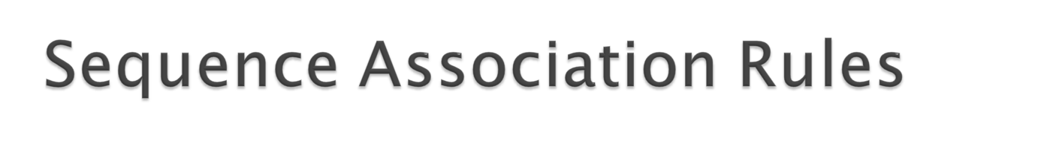
Association rules involving sequences
Ex:
<{A},{C}> ⇒ <{A},{D}>
Support = 1/3
Confidence 1
© Prentice Hall

Slide 115

Each transaction has a unique timestamp.
Group transactions based on time interval within which they occur.
Identify large itemsets by looking at transactions only in this predefined interval.
© Prentice Hall

